Slide 1

An Agentic Retrieval-Augmented Framework for
Explainable Melanoma Diagnosis using Clinical Features
Date: 18th September,2026
Team Members – G-1362
Ch. Monish – 24BD1A050E
N. Sai Ramanuja – 24BD1A0519
I. Shubham – 24BD1A051M
V. Shivakarthik – 24BD1A05K3
K. Subhash – 25BD5A0532
Mentor
Dr. K. Bhargavi

Slide 2
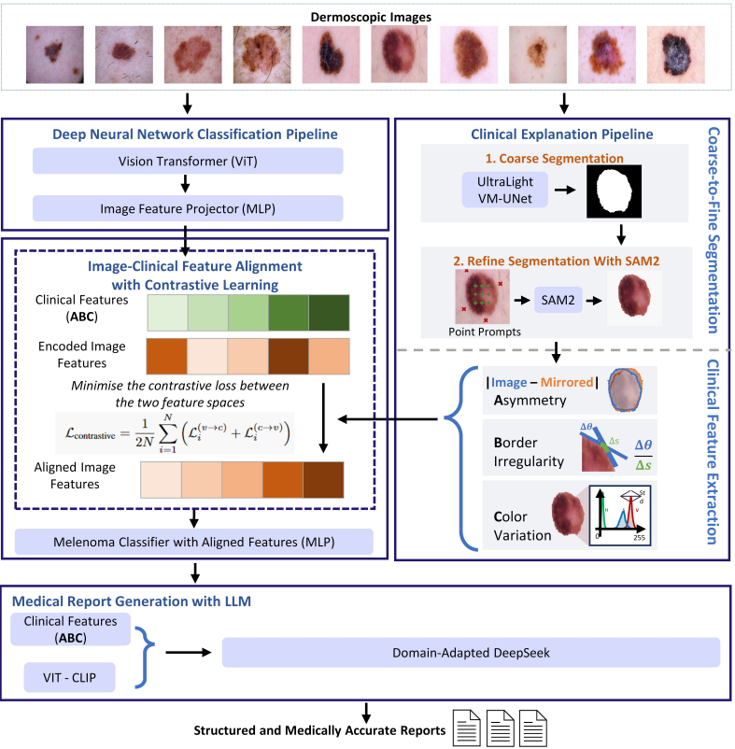
Base Paper — CEFM
Explainable Melanoma Diagnosis with Contrastive Learning and LLM-based Report Generation
Zheng et al. | December 2025
Problem: High-performing melanoma AI models can behave as black boxes, making their predictions difficult for clinicians to interpret and trust.
CEFM connects visual image features with clinically meaningful ABC features to make melanoma predictions more interpretable.
Workflow: Image -> ViT ->Lesion Segmentation -> ABC feature extraction -> Contrastive Learning Classification + Report
Results: 92.79% Accuracy | 0.961 AUC | 4.6/5 Expert Interpretability
Limitation: CEFM focuses on ABC clinical features and does not include Differential Structure analysis because fine-grained expert annotations are difficult to obtain.

Slide 3
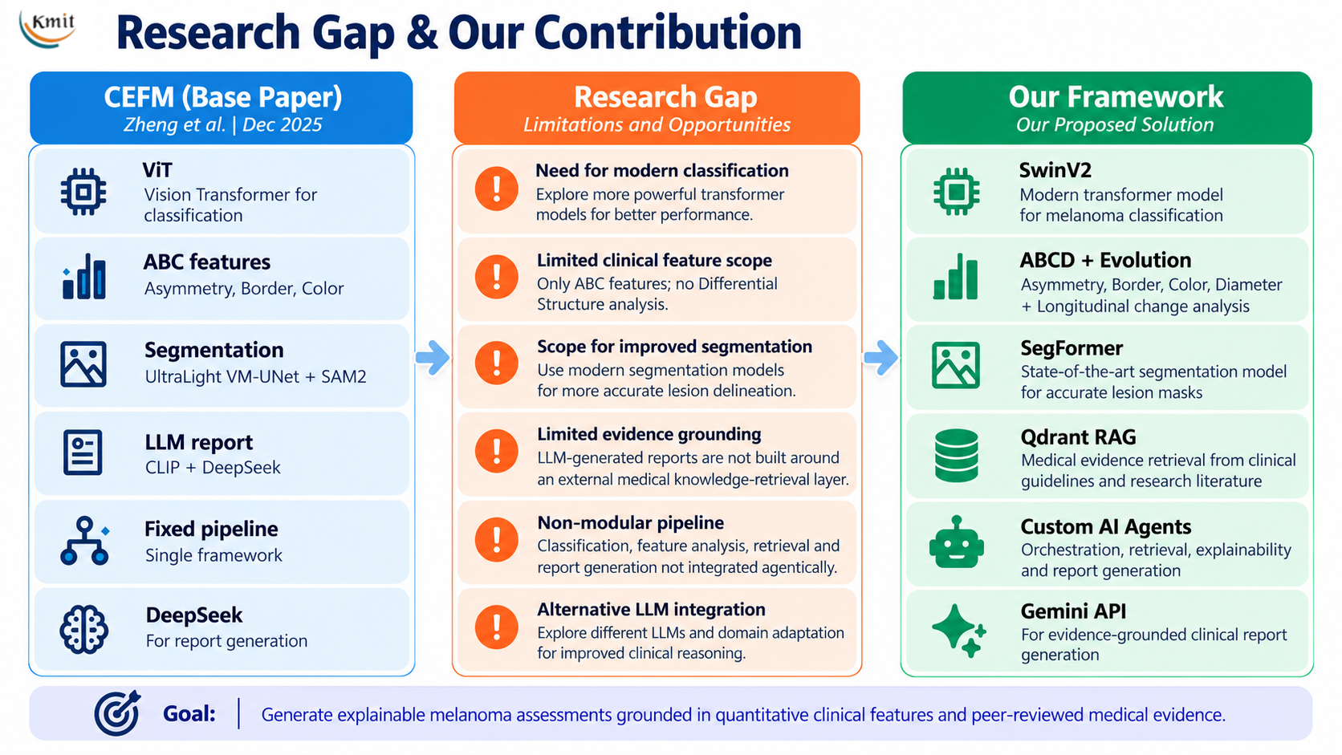

Slide 4
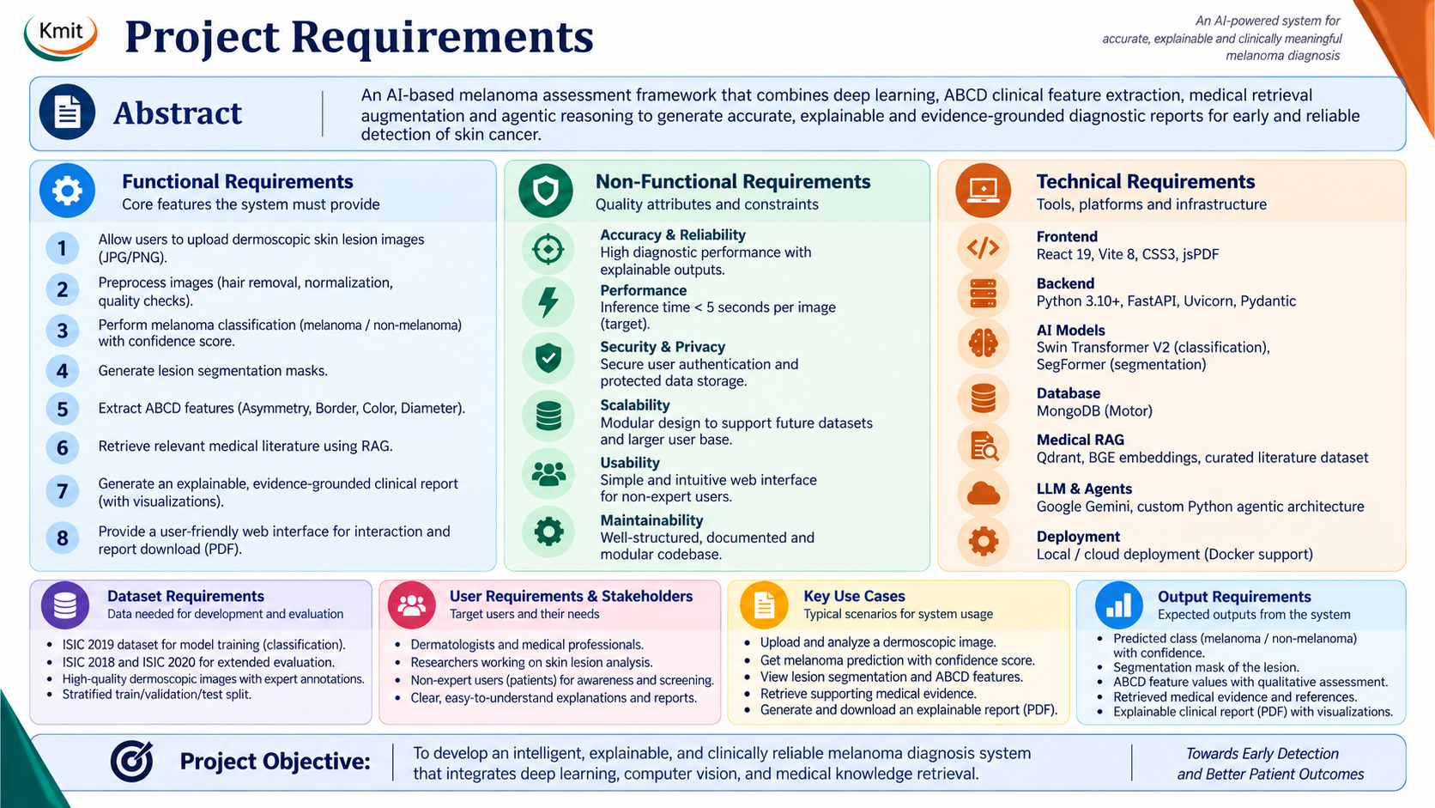

Slide 5
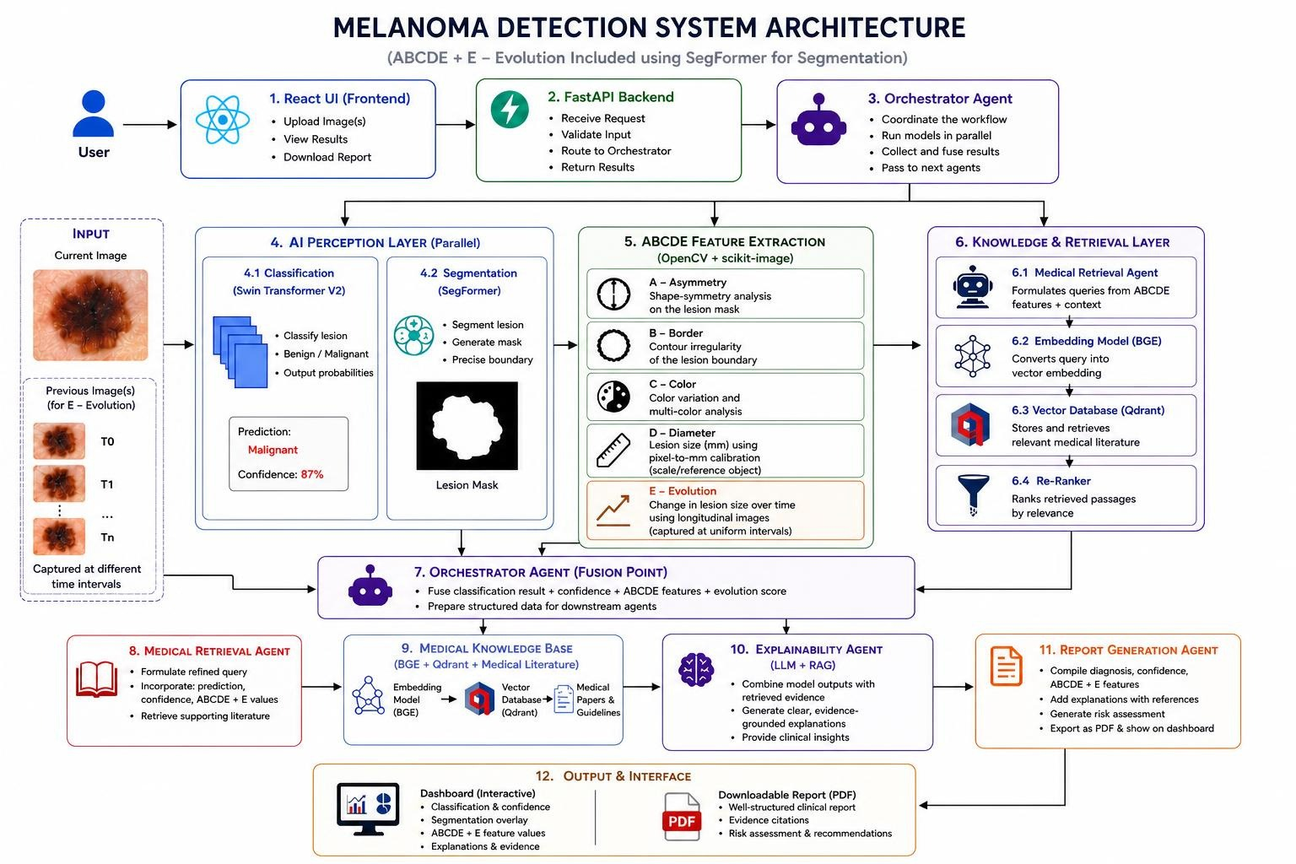
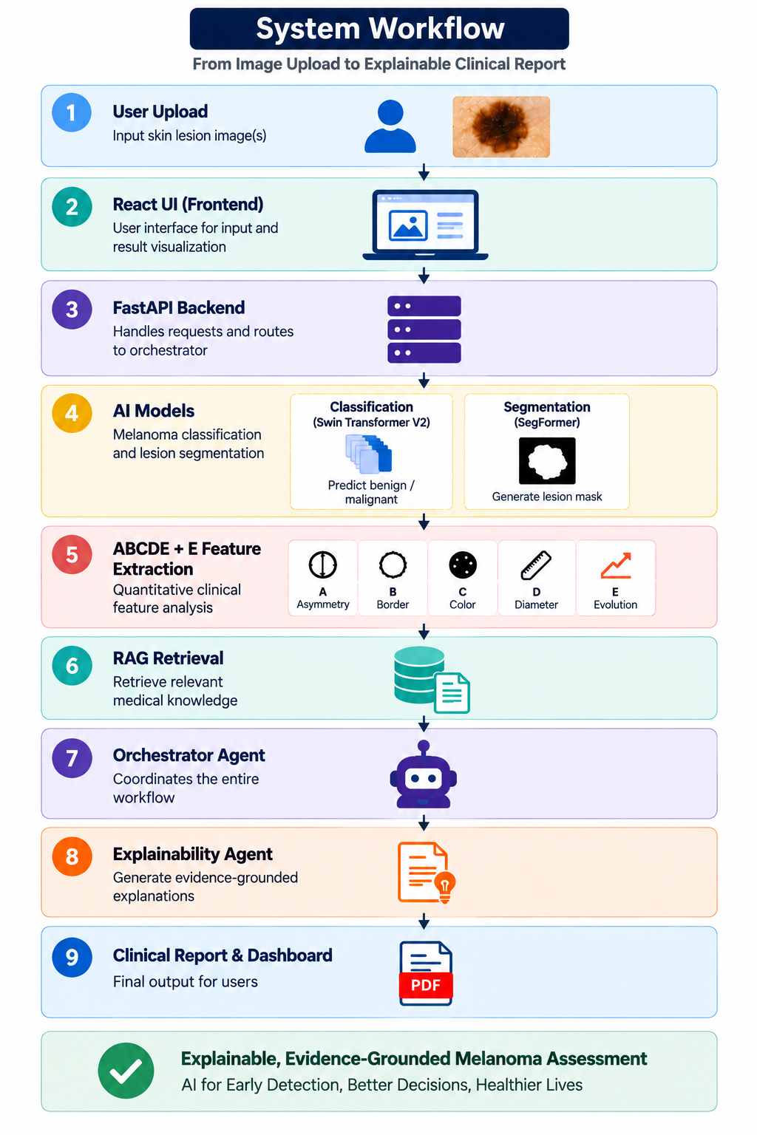
System Design : Architecture

Slide 6
Technology Stack
Frontend
React 19 + Vite 8 + CSS3 + jsPDF
Interactive dashboard, image upload, visualization and PDF export
Backend & API
Python 3.10+ + FastAPI + Uvicorn + Pydantic
REST API, validation and backend pipeline integration
Supporting Tools: NumPy Pandas scikit-learn Matplotlib pytest
Deep Learning & Computer Vision
PyTorch + Swin Transformer V2-Base + SegFormer (MiT-B2)
Classification + lesion segmentation
OpenCV + scikit-image + Albumentations
Preprocessing and ABCD feature extraction
Agentic AI & Medical RAG
Custom Python Agents + Gemini API
Orchestration, explanation and report generation
BGE-small-en-v1.5 + Qdrant
Medical knowledge embedding and retrieval
Explainability
Grad-CAM + AIL/AOL + Mask-CAM IoU + Centroid Distance
Visual attribution and explanation reliability
MongoDB + Motor
Users, diagnostic analyses, ABCD measurements, evidence and report metadata

Slide 7
Implementation: Modules
Implemented Modules
Data & Preprocessing
ISIC 2018 + ISIC 2020
Cleaning • Standardization • Hair removal • Illumination normalization
Melanoma Classification: Swin Transformer V2-Base
Binary: Melanoma / Non-melanoma
Lesion Segmentation: SegFormer (MiT-B2)
Pretrained model → Lesion mask
ABCD Feature Extraction
A Asymmetry • B Border
C Color • D Diameter
Medical RAG & Agents
BGE Embeddings → Qdrant
Custom Python AI Agents → Retrieval & Reasoning
Application & Reporting
React + FastAPI + MongoDB + Gemini API
Dashboard + Explainable Clinical Report
Current Status
~65% Project Done
Done
A B C D
Classification
Segmentation
RAG
In Progress
Agentic Orchestration
Evolution
Input: Dermoscopic Image → Output: Prediction + Mask + ABCD + Evidence-Grounded Report

Slide 8
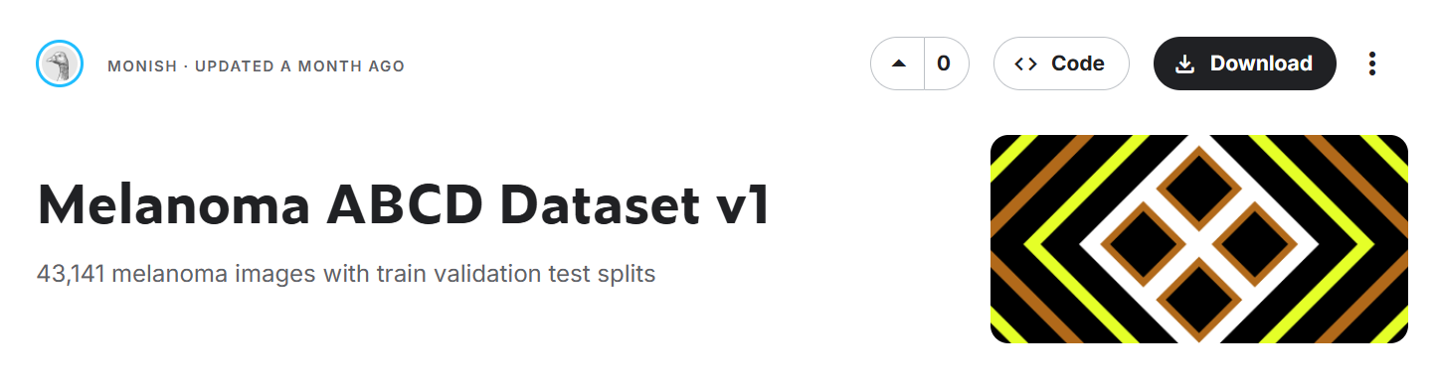
Dataset
DATASET
    Custom Curated Dataset
    ISIC 2018 + ISIC 2020
Dataset Preparation
Metadata standardized
Images cleaned & validated
Unified schema created
Preprocessing completed
Dataset integrated into pipeline
Purpose:Melanoma / non-melanoma classification and clinical feature analysis
ISIC 2018: 10,015 images
ISIC 2020: 33,126 images
Total: 43,141 unique images
Melanoma: 1,697 images (3.93%)
Non-melanoma: 41,444 images (96.07%)
Total: 43,141 images (100%)
Class imbalance: 3.93% melanoma vs 96.07% non-melanoma → weighted classification loss
DATA SPLIT
Training: 30,412 images (70.5%)
Validation: 5,975 images (13.9%)
Testing: 6,754 images (15.7%)
Total: 43,141 unique images

Slide 9
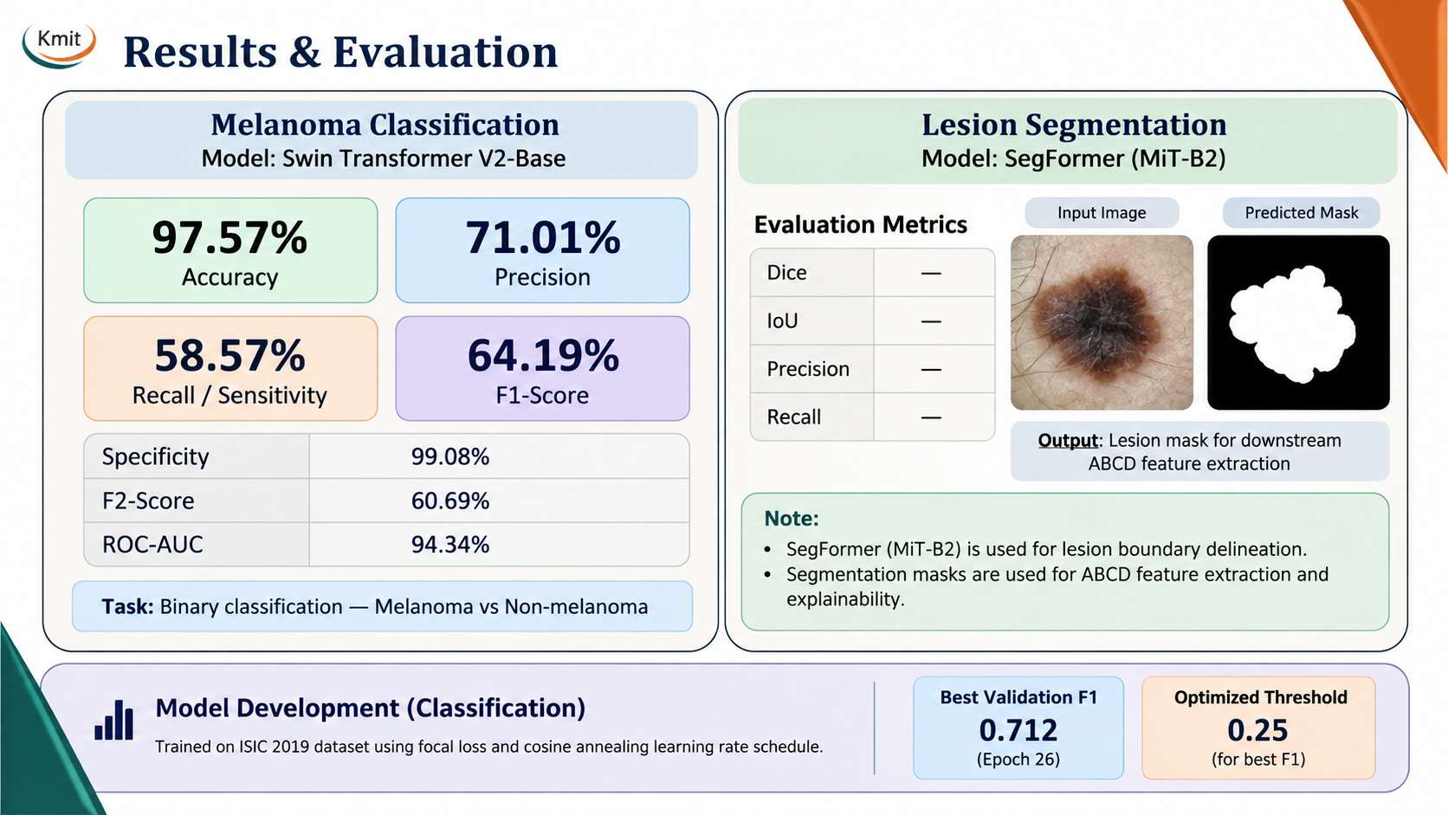
Results & Evaluation

Slide 10
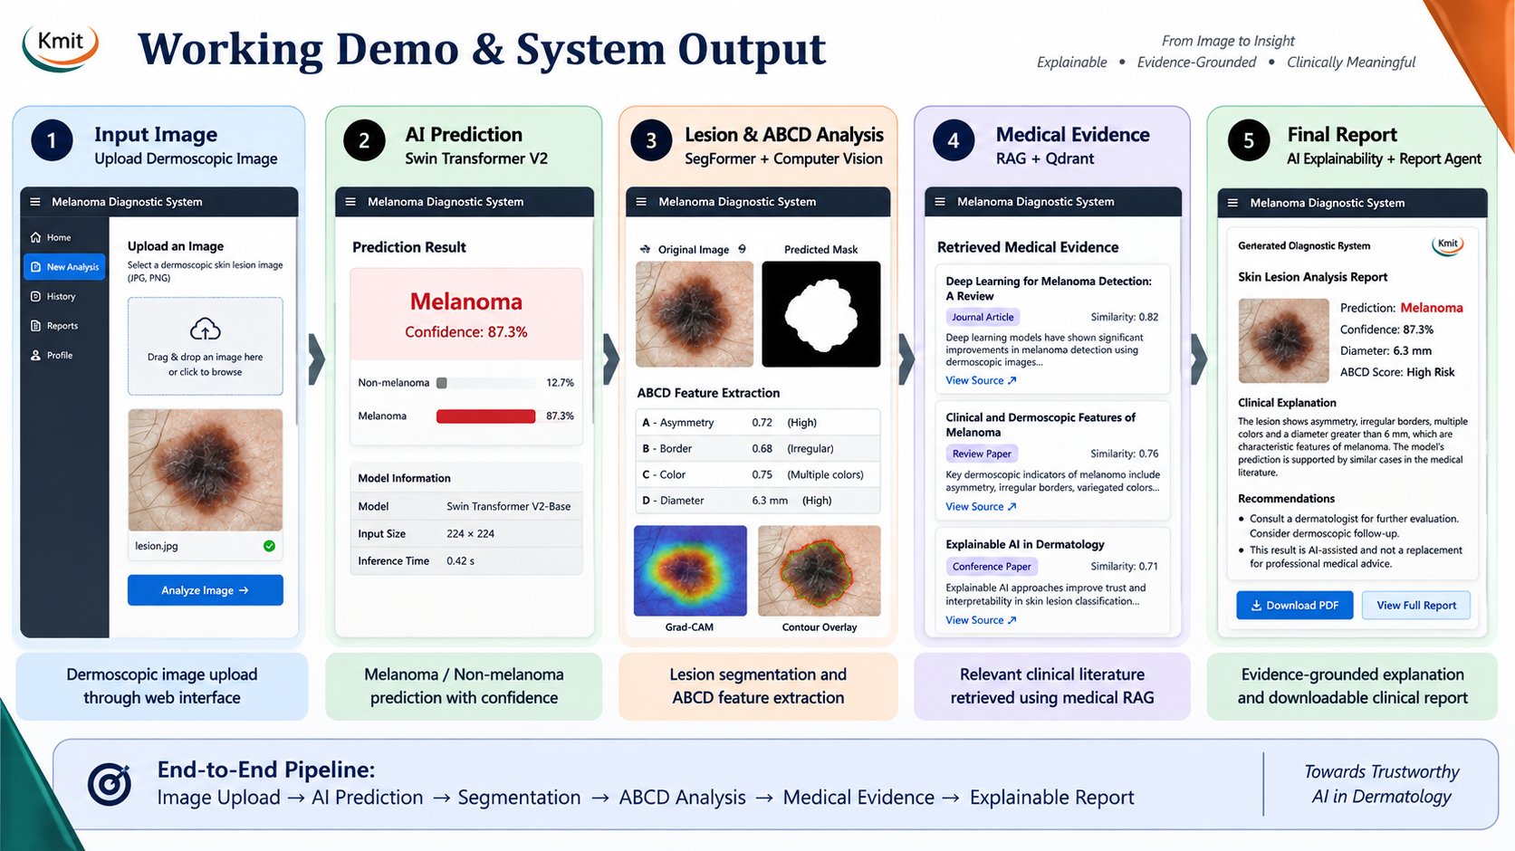
Working Demo & System Output

Slide 11
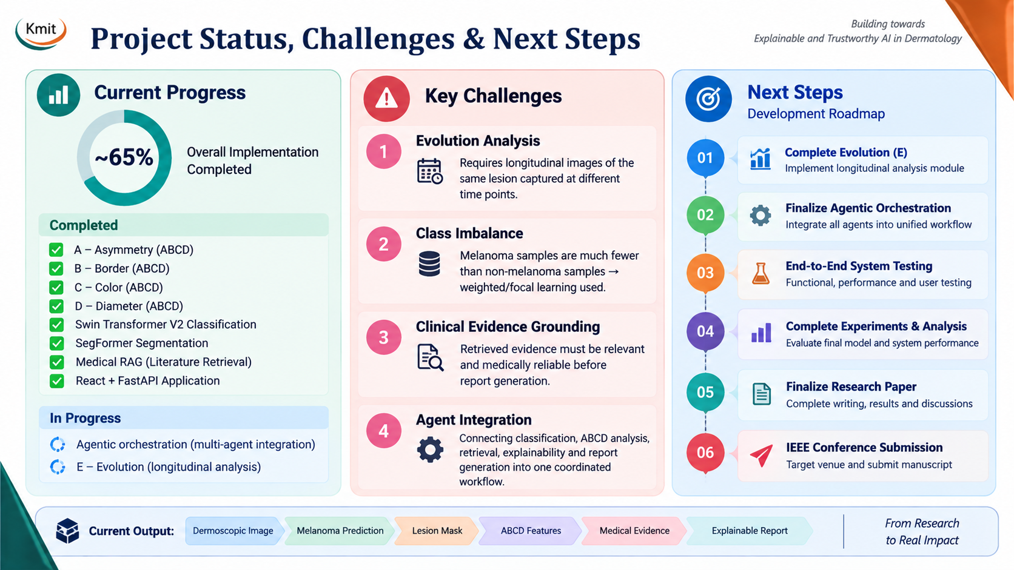
Project Status, Challenges & Next Steps

Slide 12
Paper Publication Progress
Target : IEEE Conference
Draft – Under Development
Final Paper Title
An Agentic Retrieval-Augmented Framework for Explainable Melanoma Diagnosis using Clinical Features
Literature Survey
42 papers reviewed
28 selected papers
18 selected for writing paper
8 Research Areas
ABCDE & clinical melanoma
Melanoma AI & classification
Lesion segmentation
Quantitative ABCDE extraction
Explainable AI
Longitudinal monitoring
Medical RAG & LLMs
Medical AI agents
Section | Status
Abstract | ⬜ Not Started
Introduction | ✅ Drafted
Related Work | ✅ Drafted
Methodology | 🟡 In Progress
Architecture | ✅ Completed
Results & Analysis | ⬜ Not Started
Conclusion | ⬜ Not Started
References | ✅ Drafted
Current Stage → Methodology Development → Experiments → Results & Analysis → Final Manuscript → IEEE Submission

Slide 13
Thank you!

